Slide 1

Country and Genre Analysis
Team 5: Gunita Rahman, Jeanine Woody,
Owakhela Kankhwende, Matthew Rogers

Slide 2

Our Business Problem
Major Distributors & Digital Streaming Platforms
Achieve a business model that would help to maximize profit for the promotion of an artist’s tracks
Notes:
Our Business Problem: Finding a means to maximize profits via a business model that analyzes the popularity of genres in different parts of the world to aid in planning musical promotions and tours efficiently.
Major Distributors (we’d consider our audience): Warner Music Group (Warner), Universal Music Group (Universal), and Sony Music Entertainment (Sony)
6 Artists & Genres: picked as the top for their respective genre (Spotify Wrapped 2020)
All Time Low - Rock
Bad Bunny - Latin
BTS - K-Pop
Drake - Rap
The Weeknd - Pop
Kacey Musgraves - Country
9 Countries: diverse markets and cultures
Australia
Brazil
Germany
India
Japan
Philippines
South Africa
United Kingdom
United States

Slide 3
About the Data
Data Crawled Using Spotipy
Data Size
Spotify Web Developer API
50 songs per Country Top Charts and 50 songs per “This Is…” Playlist
Notes:
Where do you extract the data and how big is your data? (If your data crawling is beyond what we cover in class, or you have spent extra effort in data crawling, you may want to elaborate here. If you used standard data crawling procedure, you may want to be brief here).
9 Country Charts and 6 artists
Got data using Spotify Web Developer API and the python package Spotipy. Hardest part was writing the code and determining the best way to extract the audio features.
Used to extract audio features of tracks in the playlists as well as song title and artist.
Audio Features: danceability, energy, key, loudness, mode, speechiness, acousticness, instrumentalness, liveness, valence, tempo, and time signature

Slide 4
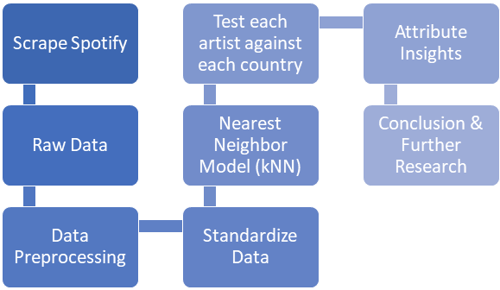
Steps Taken For Data Analysis
Data Acquisition and Exploration:
Scraping Spotify API
Identifying Predictors
Data pre-processing:
Variable coding
Selecting Prediction models
Deployment
Results
Notes:
How did you perform data analysis? Are there any pre-processing? Do you use descriptive or predictive analysis?

Slide 5

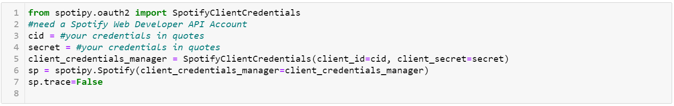
Spotify Web API
Artist Name | Genre | Record Label | Music Distributor
All Time Low | Rock | Fueled By Ramen | Warner Music Group
Bad Bunny | Latin | Universal Music Latin Entertainment | Universal Music Group
BTS | K-Pop | Big Hit Entertainment | Sony Music Entertainment
Drake | Rap | Republic Records | Universal Music Group
Kacey Musgraves | Country | Columbia Records | Universal Music Group
The Weeknd | Pop | XO | Universal Music Group
Popular Artists of various genres picked to see clear differences in trends.
Gained Spotify Client Credentials to gain access to the developer and scrape the Country Data and Artist data.

Slide 6
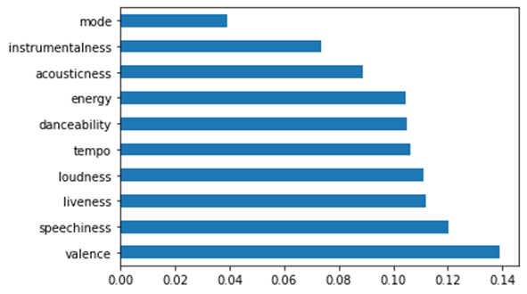
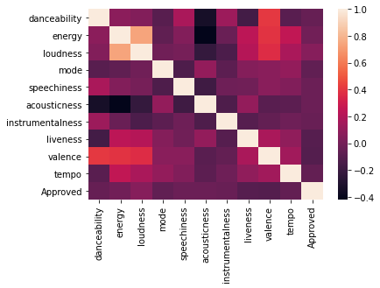
Predictor Selection
Country information was compiled into one dataset with different versions depicting an alternate Class assignment for each country.
We narrowed down the attributes to danceability, energy, loudness, key, mode, speechiness, acousticness, instrumentalness, liveness, valence, time signature and tempo. Partly chosen due to industry knowledge and partly due to Spotify descriptions of the variables. These would be further narrowed down as we built our models.
Notes:
Python screenshot

Slide 7
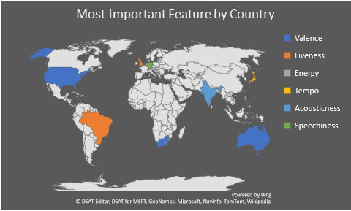
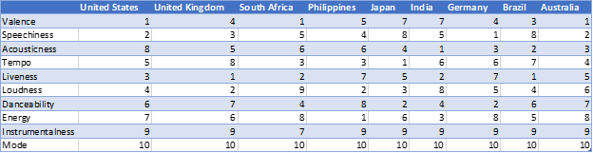
Feature Importance by Country
Insights on each country’s most important feature were found using ExtraTreesClassifier
Each country has its own unique ranking of feature importance
Top ranked features:
Australia - Valence
Brazil - Liveness
Germany - Speechiness
India - Acousticness
Japan - Tempo
Philippines - Energy
South Africa - Valence
UK - Liveness
US - Valence

Slide 8
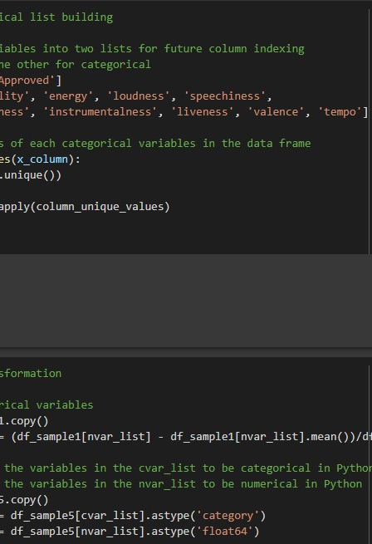
Variable coding
We identified Mode, Key and Time Signature as the Categorical variables due to their distinct discrete values
The other variables were standardized and added to the Numerical variable list
The values for Key and Time_signature can vary greatly between datasets, causing issues when fitting models to new data. These were then dropped for a uniform, simpler approach.
Notes:
Python Screenshot

Slide 9
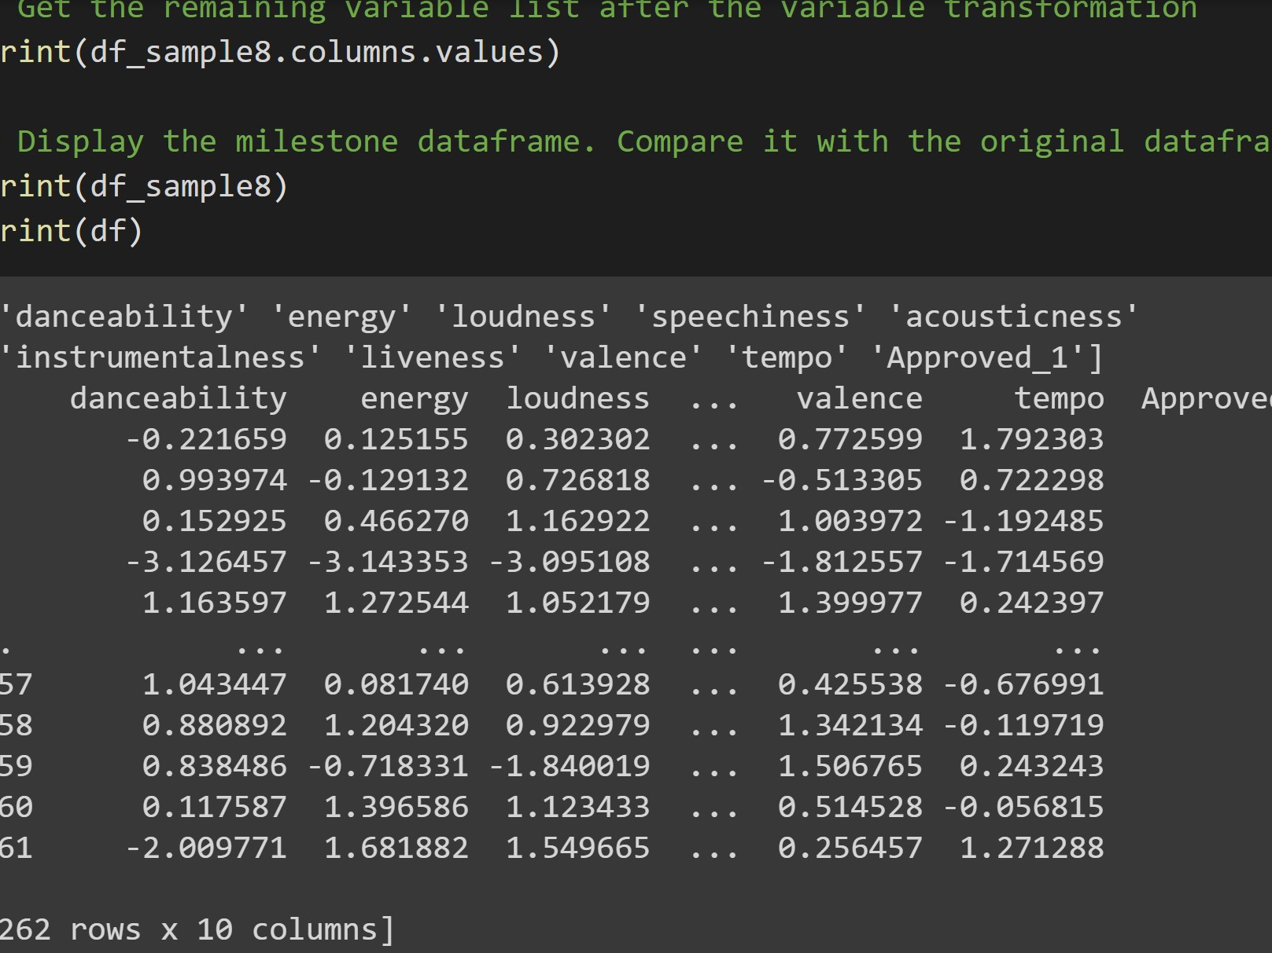
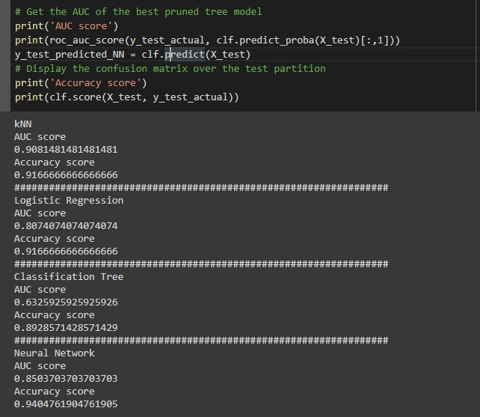
Selecting the Prediction Model
We tested Logistic Regression, Classification Tree, Neural Network and Nearest Neighbor models for best AUC and Accuracy score.
Nearest neighbor quite consistently gave the best AUC and Accuracy for multiple variations along with Neural network
Nearest Neighbor was chosen als as it is the most suited for our situation - a smaller dataset with which we would like to test the similarity or “proximity” of new data.

Slide 10
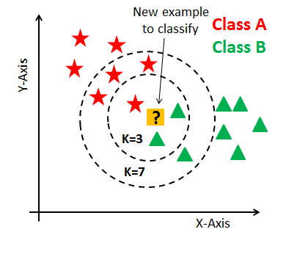
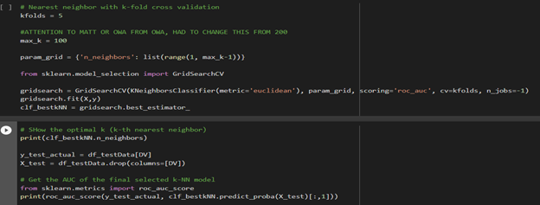
Nearest Neighbors - kNN
As our datasets were relatively small consisting of 420 observations with 50 in the (1) class and further reduced when dealing with duplicates. We opted for the Nearest Neighbour model to utilize prediction by “proximity”
9 kNN models were made for the 9 countries, built on variations of the country dataset with different (1) classes.
We then optimized the kNN model using the GridSearchCV method and searched for the optimal k with which we could achieve the best results
Notes:
Python Screenshot

Slide 11
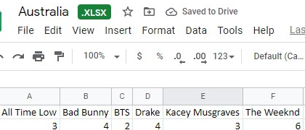
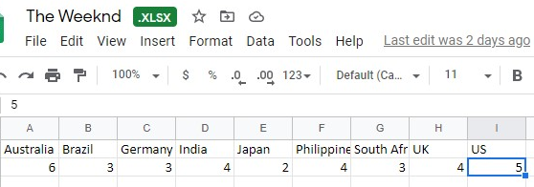
Testing new data and compiling results
Each artist’s “This is” dataset consisting of their historically most popular songs were tested by each country’s model.
Songs predicted to be of the “1” class and so deemed as potentially popular in that country were counted.
Two collection of files detailing Song Count for each Artist by Country and Song Count for each Country by Artist were created

Slide 12
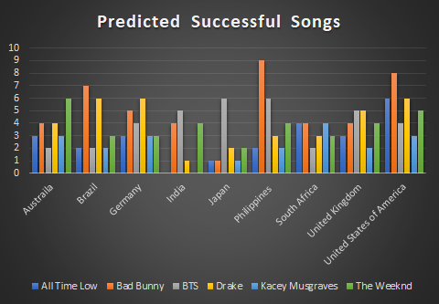
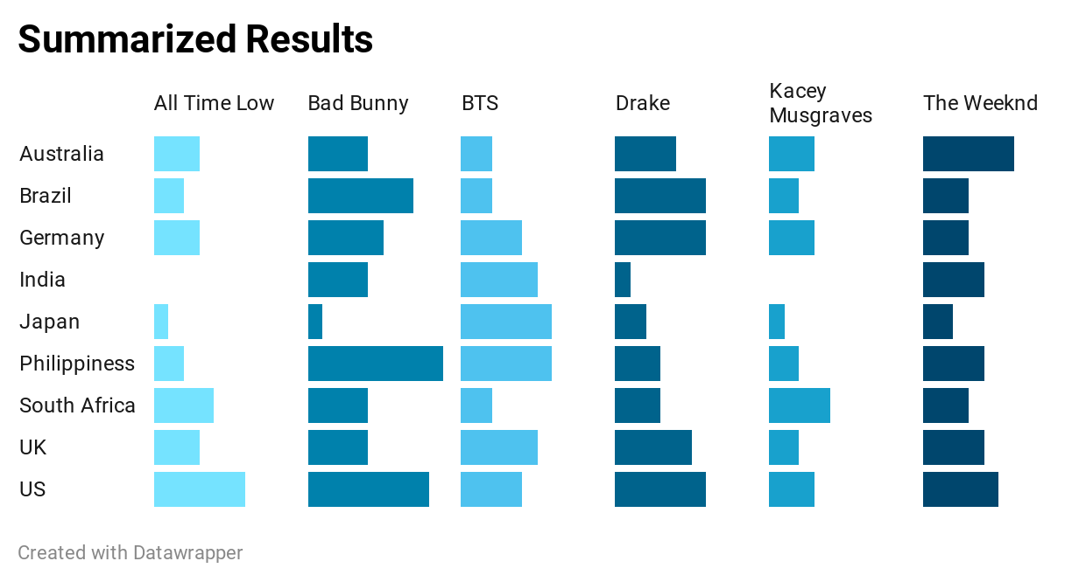
Results
Artist’s results were spit out by each country’s optimized KNN model to predict how many of their “This is” playlist tracks would make it to the country’s “Top 50”
Results could be used by Major Music distributors various ways
Encourage artist expansion into new markets
Avoid investing resources in predicted less promising markets
Reaffirm an artist’s current investment in a market
Text explaining results?
Notes:
This is another main part of your presentation. If you have posed multiple questions in the first section, here you will try to answer each of the questions using your analysis results. (If there are some final results that is not ready for the presentation, you can still include them in the final report. However, you should have most of your analysis results at this point).

Slide 13
Best of Country
Australia - The Weekend
Brazil - Bad Bunny
Germany - Drake
India - BTS
Japan - BTS
Philippines - Bad Bunny
South Africa - All Time Low, Bad Bunny, Kacey Musgraves
United Kingdom - BTS, Drake
United States - Bad Bunny

Slide 14
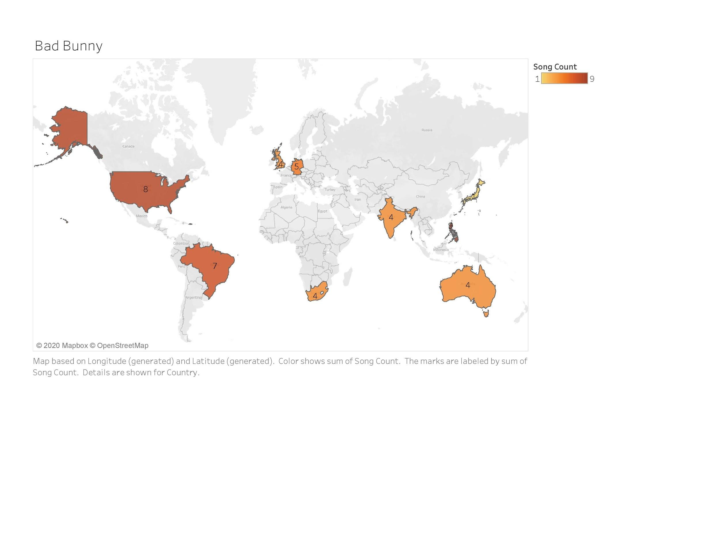
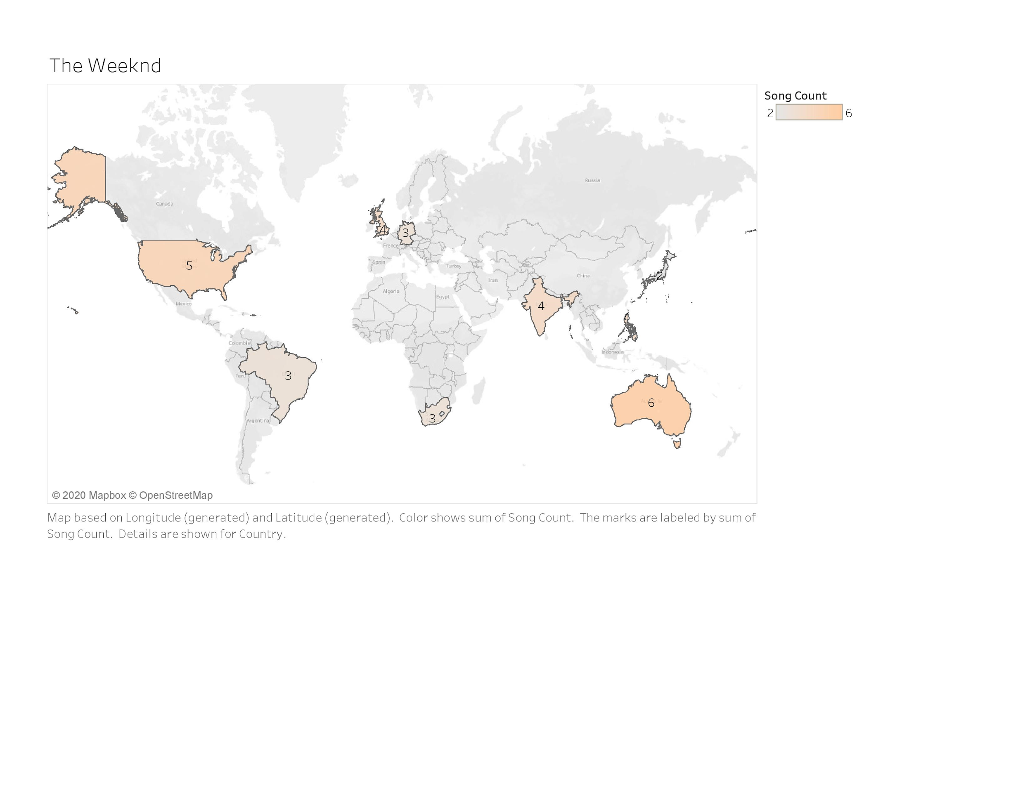
Bad Bunny & The Weeknd Results

Slide 15
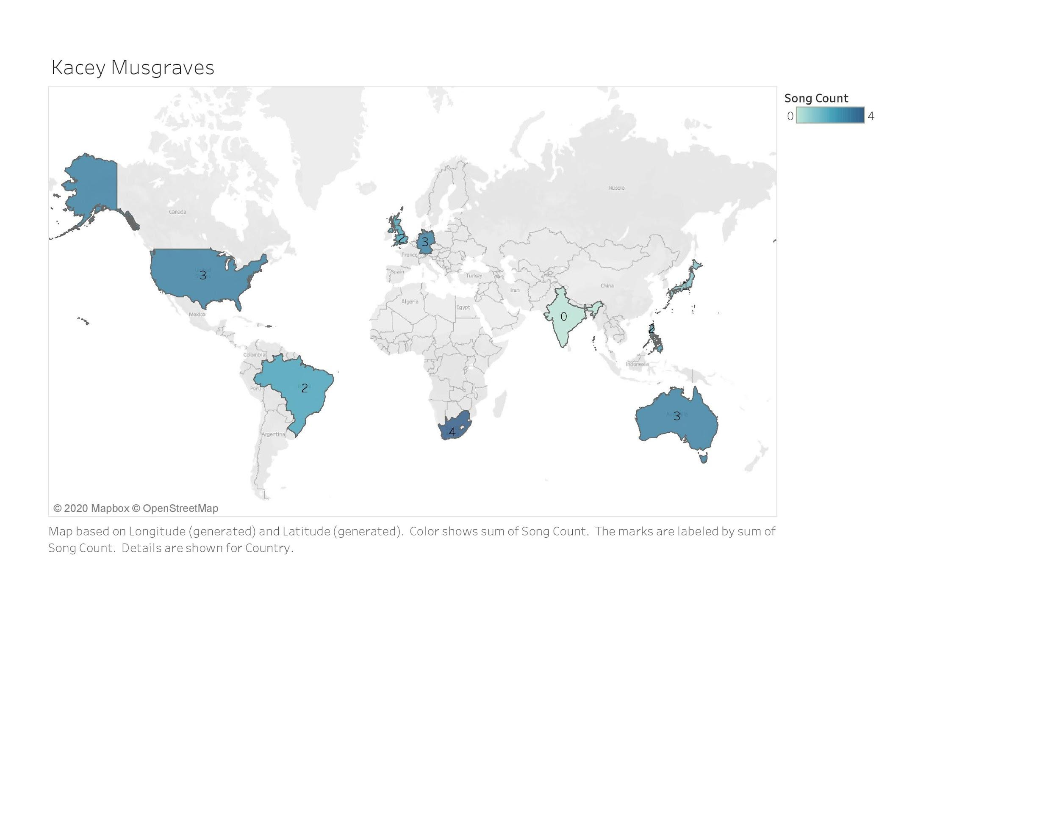
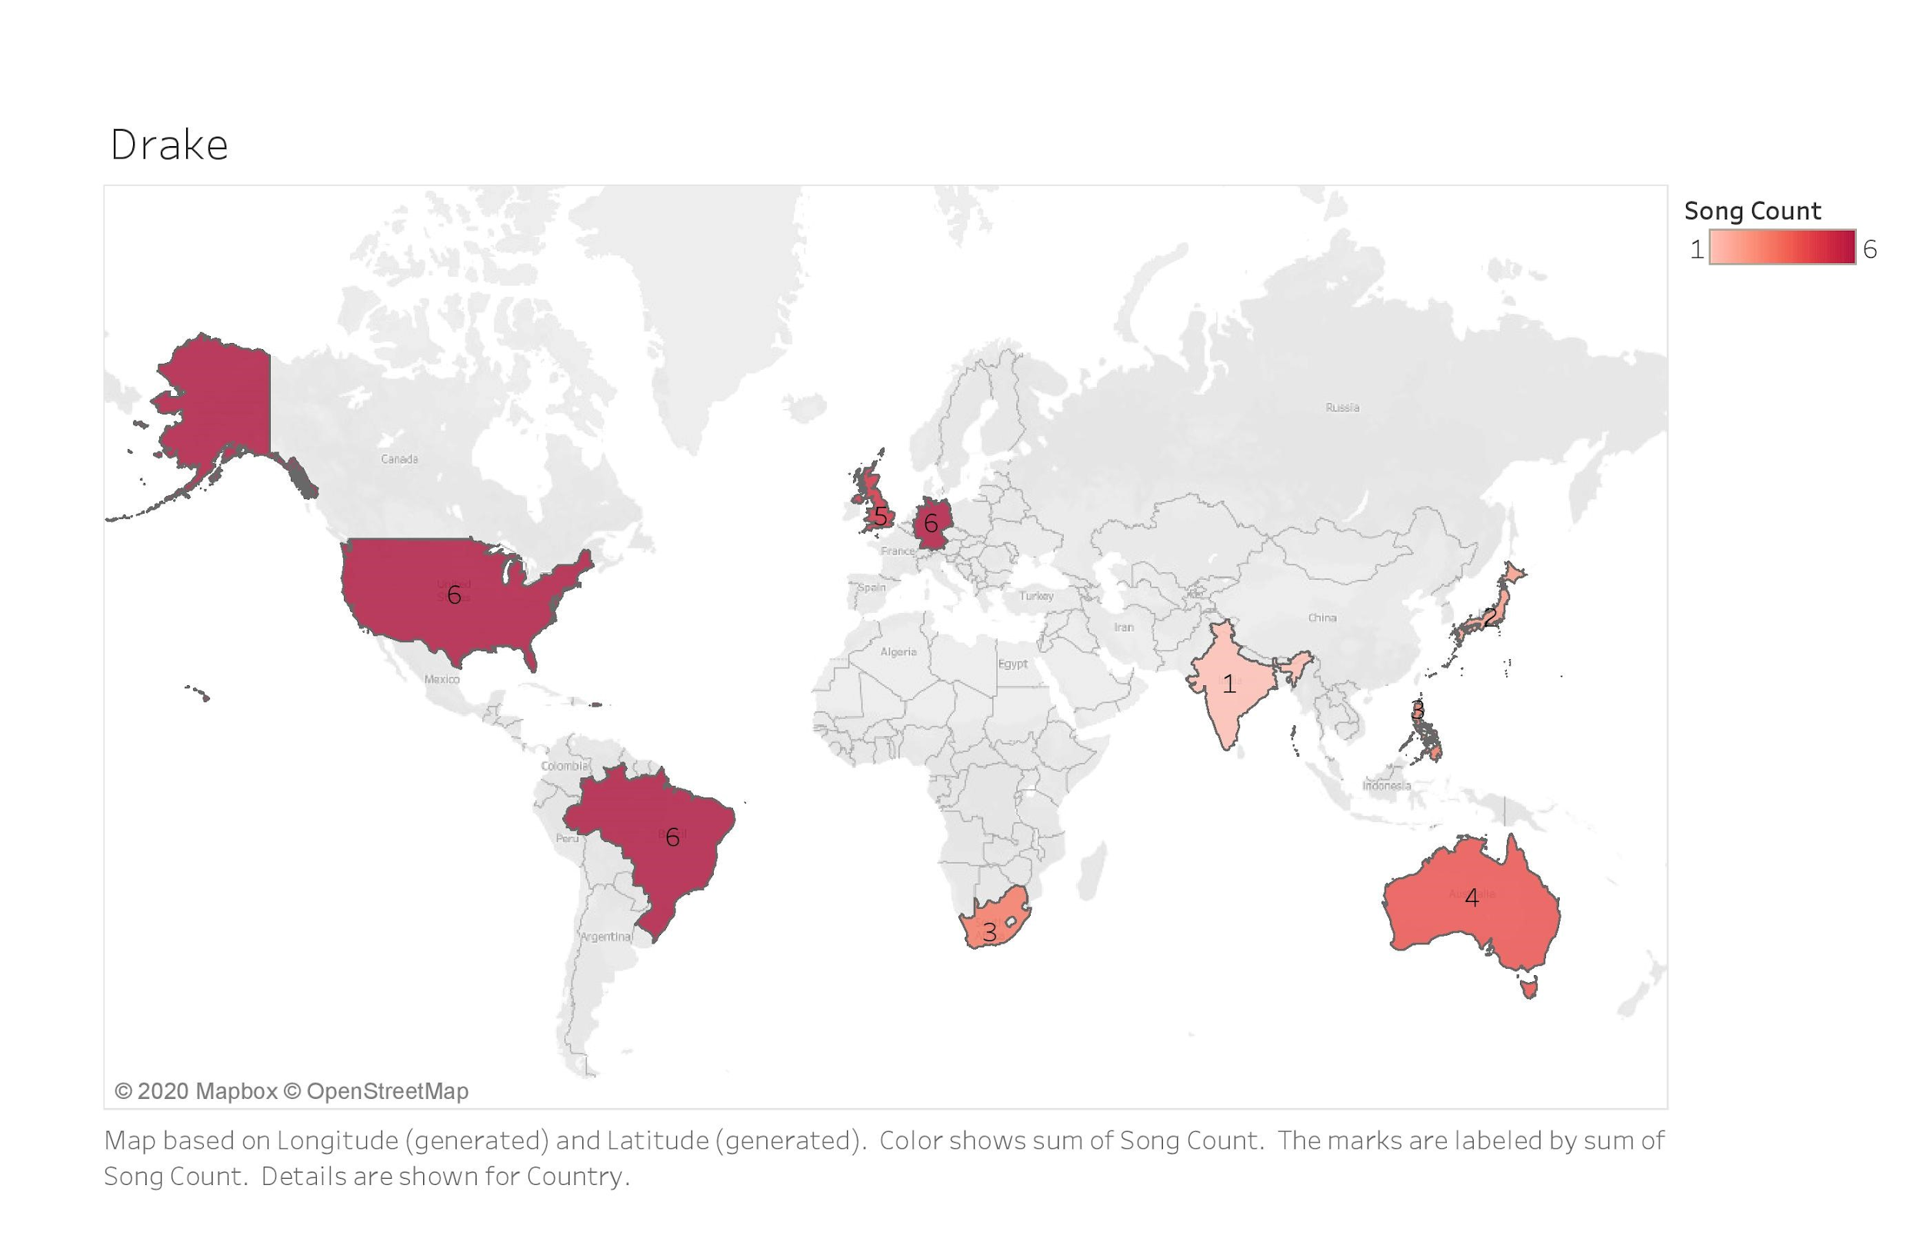
Kacey Musgraves & Drake Results

Slide 16
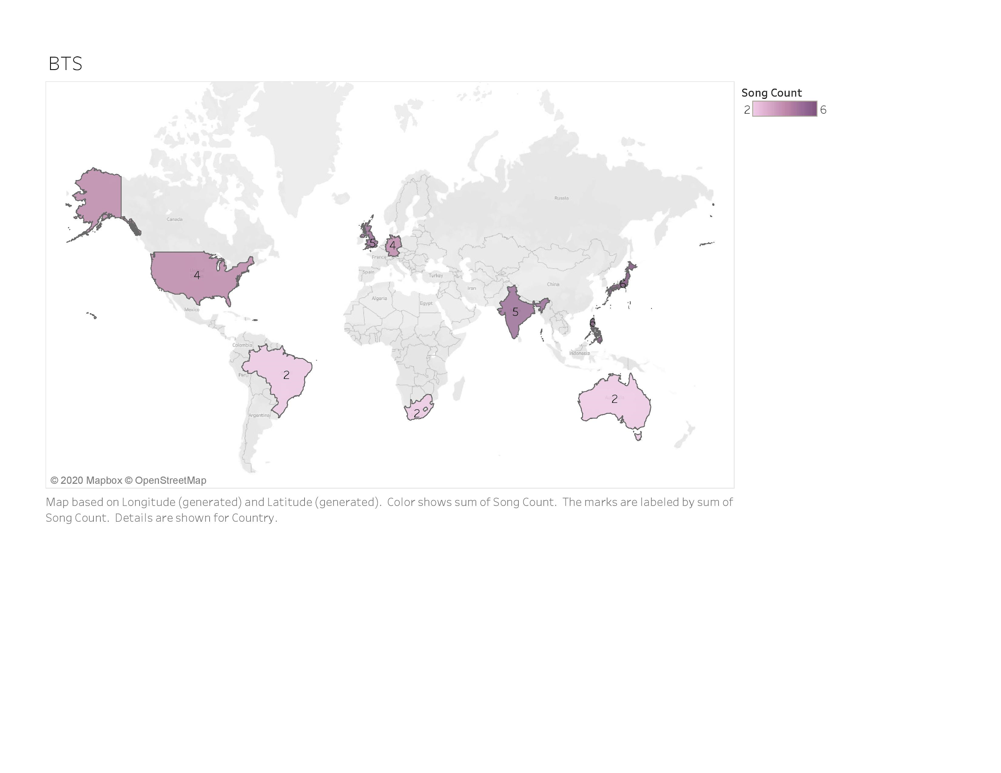
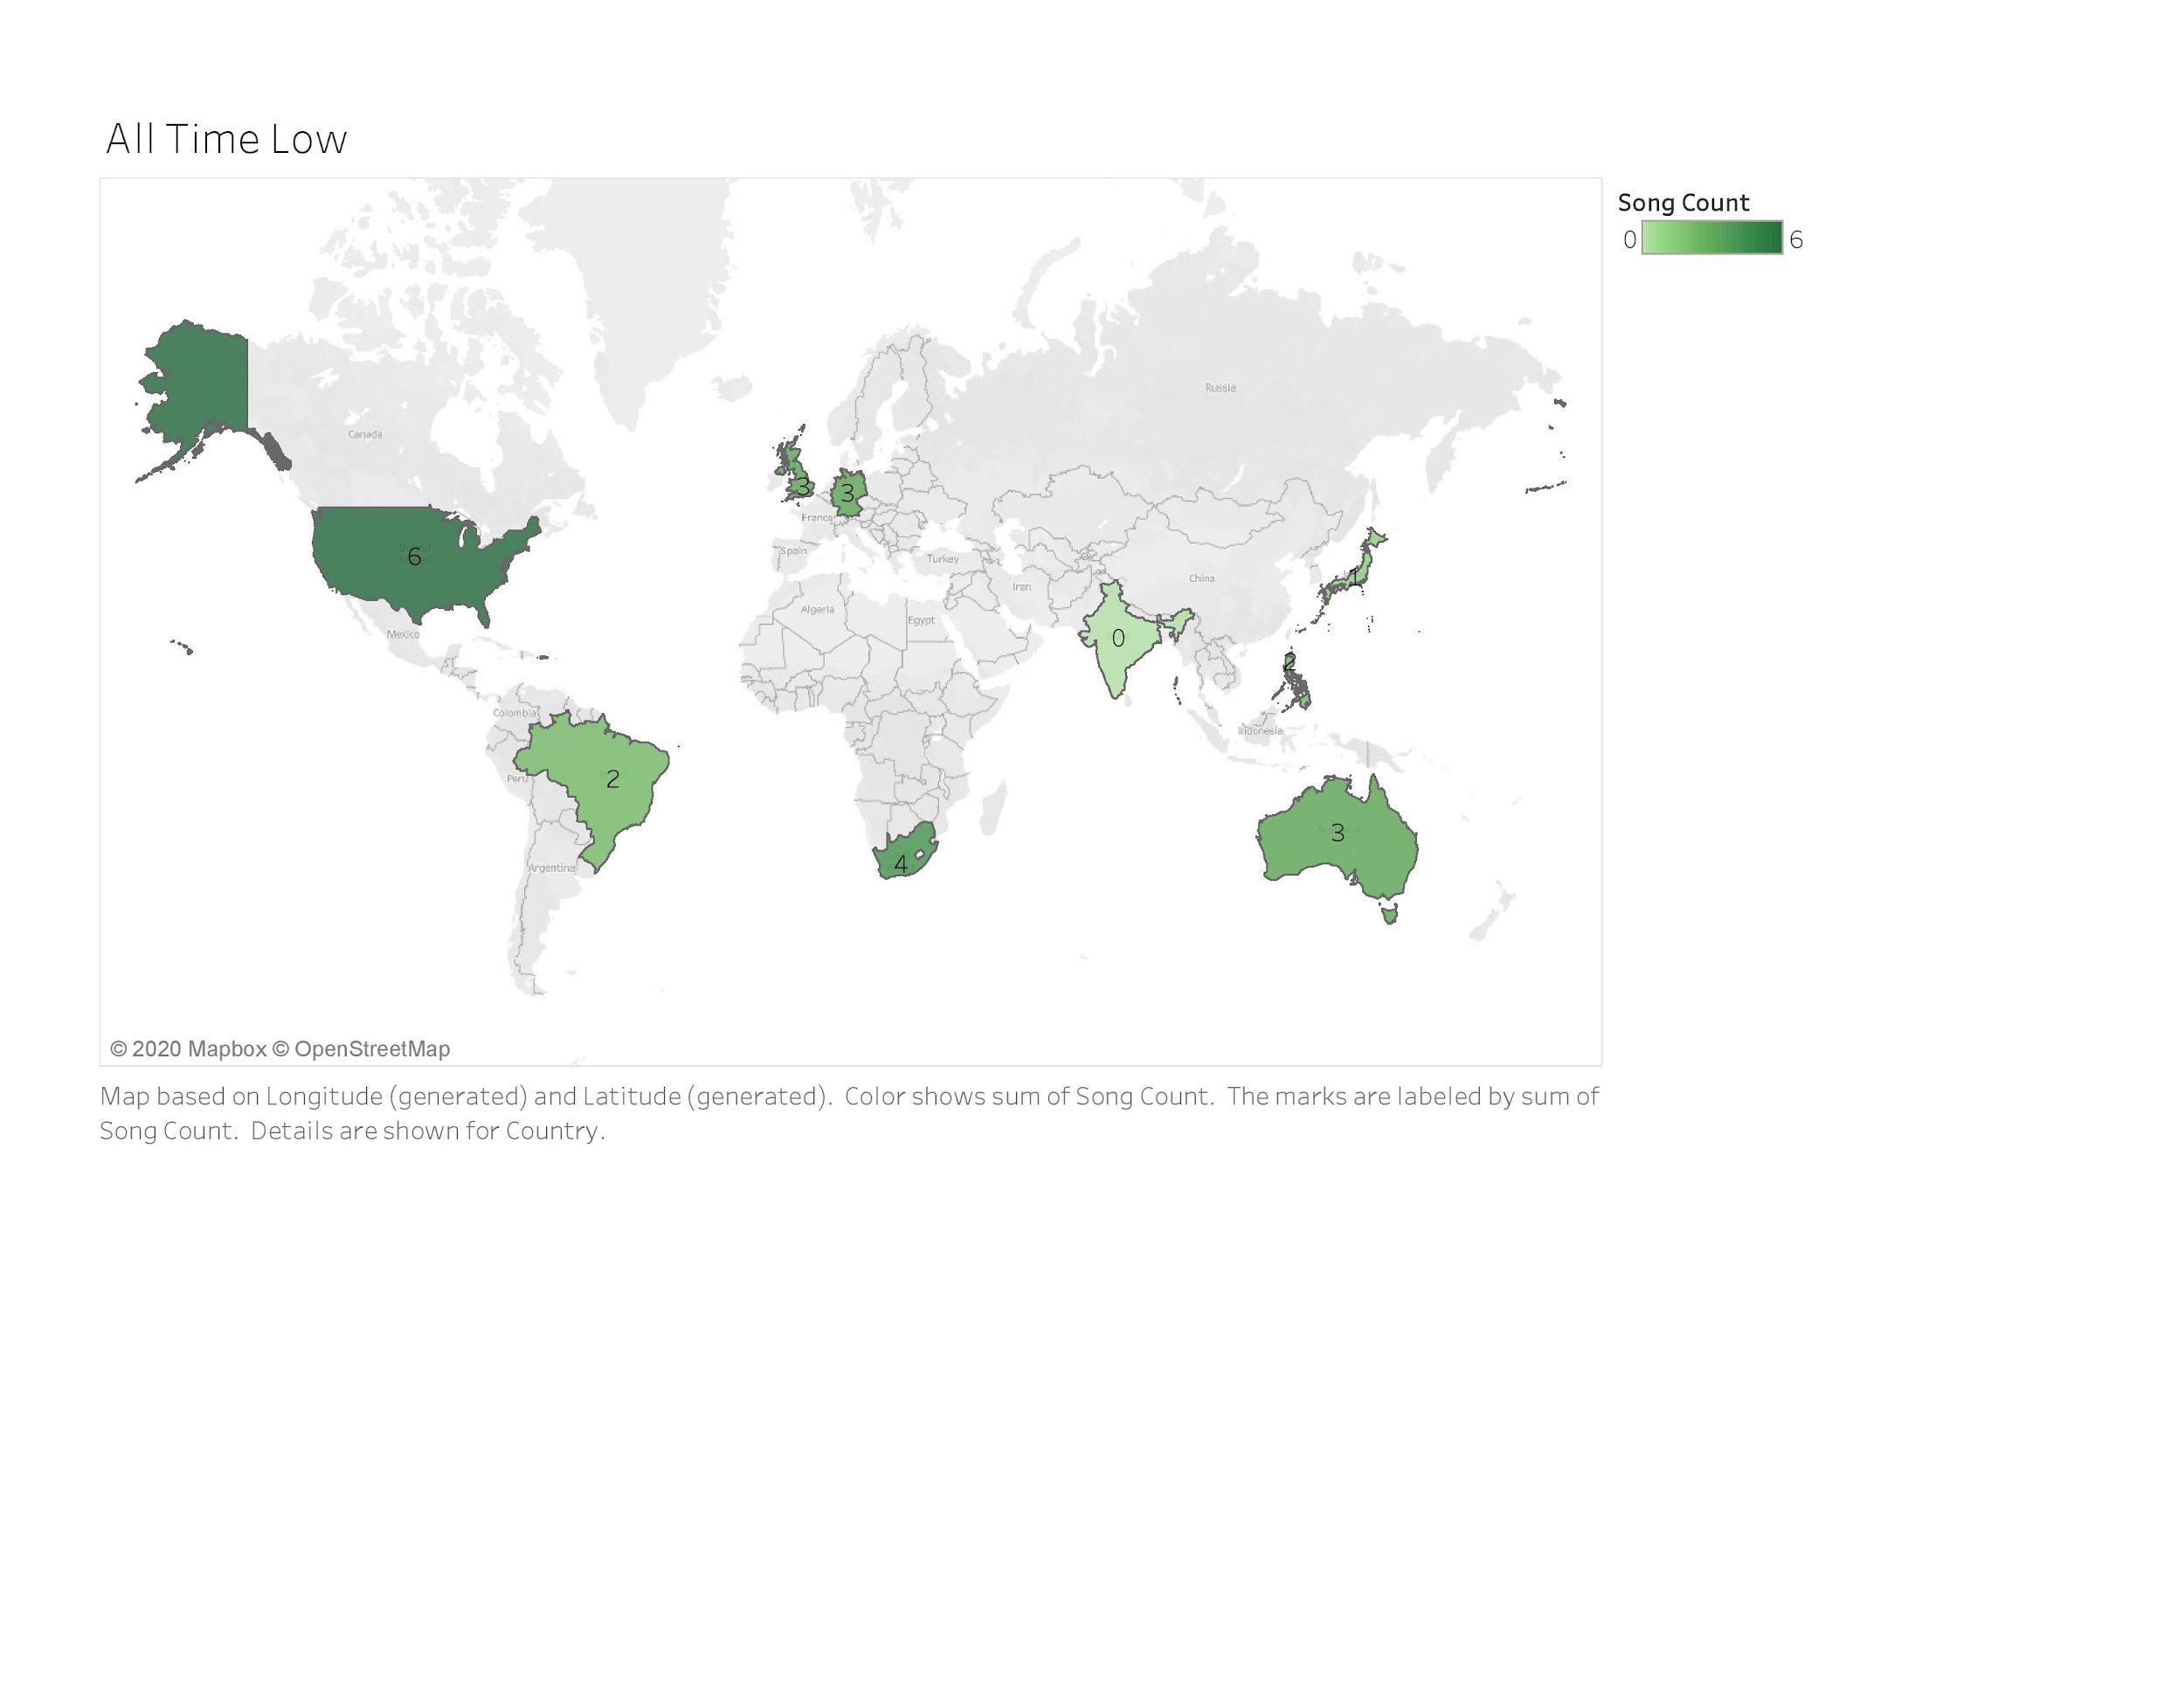
BTS & All Time Low
Results

Slide 17
Conclusion
Latin Music Topped Global Charts
For Future Research
Through our research it was concluded, that the genre of Latin music was the most popular among the other genres analyzed globally.
Expand to include Top 50 data from all 92 countries using Spotify and include more musical artists of more diverse subsets of genres.
Notes:
Globally: aka the nine diverse countries we crawled from
Latin music: represented by Bad Bunny

